Slide 1
US Wildfire Behavior Over Time
Team Members:
Michael Turnell
Suparna Bhattacharjee

Slide 2
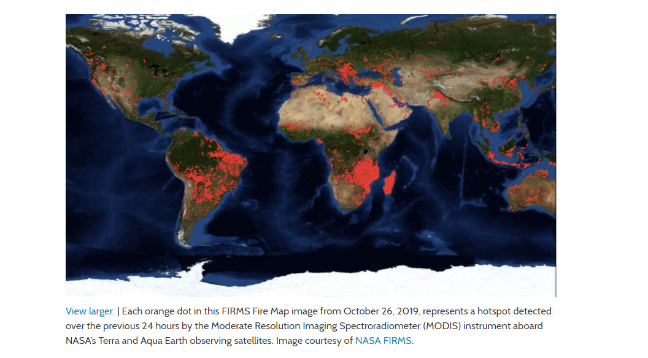
1. Frequent fire incidence occurrences around the globe 2. Climate change 3. Impact on and by Humans
INSPIRATION
Is Earth on Fire?
Picture 1
-Analyzing wildfire occurrences across US from 2000-2015, and study the trend, cause and impact on weather, humans and vice-versa.

Slide 3
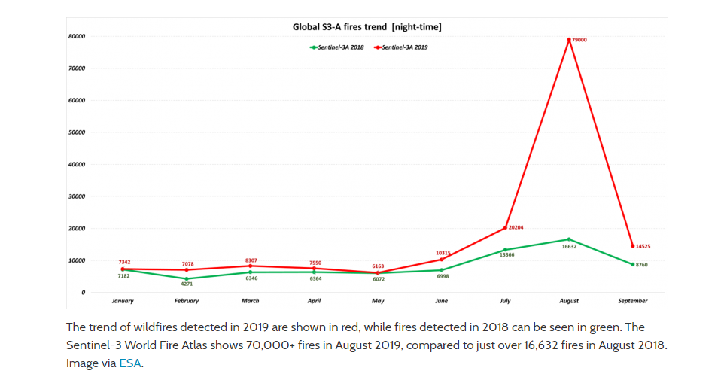
Wildfire Trend – 2019 Vs 2018 by month
Picture 2

Slide 4
QUESTION AND DATA

Slide 5
QUESTION AND DATA

Slide 6
QUESTION AND DATA

Slide 7
DATA CLEAN UP AND EXPLORATION
ALGORITHM
1.
2.
3.
COLLECT WILDFIRE DATA (KAGGLE)
PERFORM DATA CLEANING
ANALYSIS
GRAPHS AND PLOTS

Slide 8
DATA CLEAN UP AND EXPLORATION
Types of graphs and analysis

Slide 9
1. Spatial Merging of the wildfire dataset with the weather data due to time constraint 2.
LIMITATIONS AND CHALLENGES

Slide 10
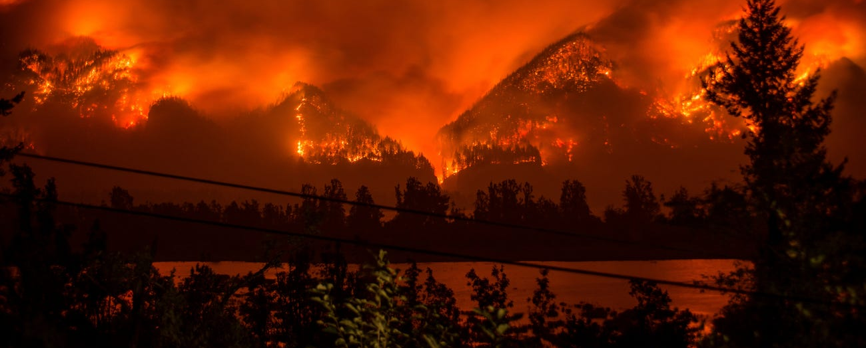
CONCLUSION
Picture 3
1.
2.
3.

Slide 11
References:
1. Wildfire Dataset:
2. Weather Dataset:
3.
4.
5.
6. Picture References on the Slide:
Picture1 on Slide 2- https://firms.modaps.eosdis.nasa.gov/map/#z:2;c:46.4,-1.9;t:adv-points;d:2019-10-26..2019-10-26;l:firms_viirs,firms_modis_a,firms_modis_t
Picture 2 on Slide 3- https://earthsky.org/earth/wildfires-summer-2019-esa-world-fire-atlas
Picture 3 on Slide 11 - https://www.businessinsider.com/wildfire-season-western-us-2017-9

